Slide 1
What is an Operating System?
A virtual machine
  Hides the complexity and limitations of hardware from application programmers
Applications
Virtual machine interface
Operating system
(virtual machine)
Physical machine interface
Raw machine

Slide 2
What is an Operating System?
An Operating System is an integrated set of programs which controls the overall operations of the computer system and acts as a supervisory agent between the hardware, applications and users.

Slide 3
For Each OS Component
There are two major design questions:
  What is the hardware interface?
    The physical reality
  What is the application interface?
    The nicer abstraction

Slide 4
Reality vs. Abstraction
Reality | Abstraction
A single CPU | Multiple CPUs
Limited RAM capacity | Infinite capacity
Mechanical disk | Memory speed access
Insecure and unreliable networks | Reliable and secure
Many physical machines | A single machine

Slide 5
Two General OS Functions
Standard services
  Screen display
  Disk accesses
Coordination among applications
  Goals: correctness, efficiency, and fairness

Slide 6
Standard Services
Example: disk drive
Track
Sector
Cylinder

Slide 7
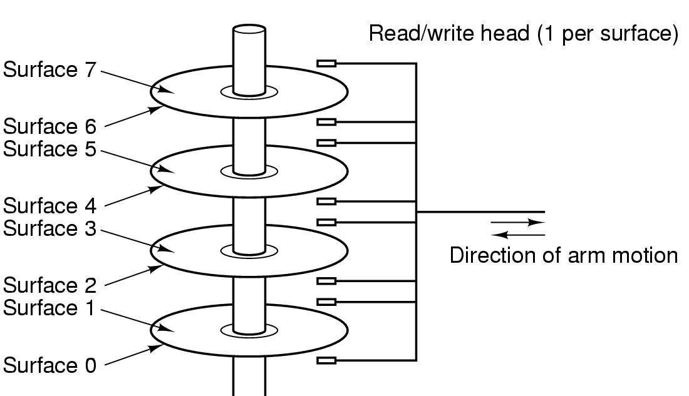
Computer Hardware Review
Structure of a disk drive

Slide 8
Disk Access
Raw disk access
  write(block, len, device, track, sector);
OS-level access
  lseek(file, file_size, SEEK_SET);
  write(file, text, len);

Slide 9
Coordination
Example: Protection
  Applications should not crash one another
    Address space: all memory addresses that an application can touch
  Applications should not crash the OS
    Dual-mode operations
      Kernel mode: anything goes
      User mode: an application can only access its own address space

Slide 10
Four Recurring Themes
OS as an illusionist
  Overcomes hardware limitations
OS as a government
  Protects users from one another
  Allocates resources efficiently and fairly
OS as a complex system
OS as a history teacher
  Learns from the past to predict the future

Slide 11
History of OS: Change!
 |  | 1980 | 2000 | Factor
Speed | CPU | 1 MIPS | 1,000 MIPS | 1,000
 | Memory | 500 ns | 2 ns | 250
 | Disk | 18 ms | 2 ms | 9
 | Modem | 300 bits/sec | 56 Kbits/sec | 200
Capacity | Memory | 64 Kbytes | 128 Mbytes | 2,000
 | Disk | 1 Mbytes | 6 Gbytes | 6,000
Cost | Per MIP | $100K | <= $1 | 100,000
Other | Address bits | 8 | 64 | 8
 | Users/machine | 10s | <=1 | .01

Slide 12
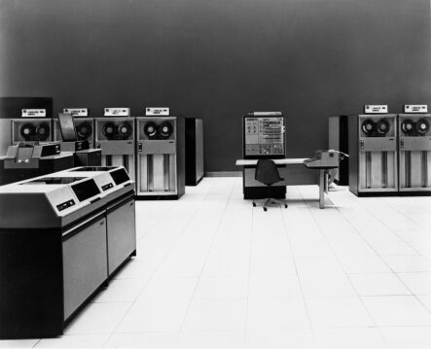
History Phase I: Hardware Expensive, Humans Cheap
Hardware: mainframes
OS: human operators
  Handle one job (a unit of processing) at a time
  Computer time
  wasted while
  operators walk
  around the
  machine room

Slide 13
OS Design Goal
Efficient use of the hardware
  Batch system: collects a batch of jobs before processing them and printing out results
    Job collection, job processing, and printing out results can occur concurrently
  Multiprogramming: multiple programs can run concurrently (at the same time)
    Example: I/O-bound jobs and CPU-bound jobs

Slide 14
Multiprogramming
Multiprogramming is a rudimentary form of parallel processing in which several programs are run at the same time on a uniprocessor. Since there is only one processor, there can be no true simultaneous execution of different programs.
Instead, the operating system executes part of one program, then part of another, and so on. To the user it appears that all programs are executing at the same time.
If the machine has the capability of causing an interrupt after a specified time interval, then the OS will execute each program for a given length of time, regain control, and then execute another program for a given length of time, and so on.

Slide 15
Multiprogramming
In multiprogramming system, when one program is waiting for I/O transfer; there is another program ready to utilize the CPU. So it is possible for several jobs to share the time of the CPU (Time Multiplexing)
But it is important to note that multiprogramming is NOT defined to be the execution of jobs at the same instance of time. Rather it means that there are a number of jobs available to the CPU (placed in main memory) and a portion of one is executed, then a portion of another and so on.

Slide 16
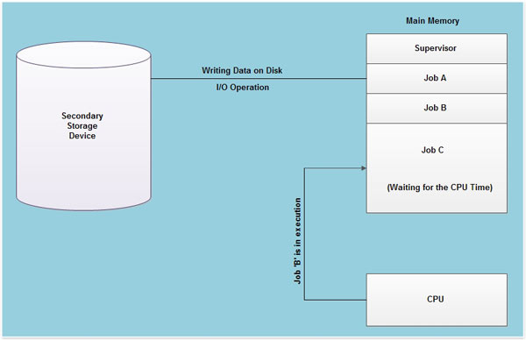

Slide 17
Multitasking
An multitasking operating system gives you the perception of 2 or more tasks/jobs/processes running at the same time. It does this by dividing system resources amongst these tasks/jobs/processes. And switching between the tasks/jobs/processes while they are executing very fast, over and over again.
Multitasking is a logical extension of multiprogramming system that supports multiple programs to run concurrently. In multitasking more than one task are executed at the same time.
In this technique the multiple tasks, also known as processes, share common processing resources such as a CPU → also called Multiplexing

Slide 18
Types of Multiplexing
The idea of Multiplexing is associated with sharing of resources
Hence the System Resource Management is being done by the OS
There are two types of multiplexing:
Time Multiplexing
  CPU → sharing of the processor by several programs one at a time; based upon some decision…
  Printer → when multiple programs queue up for printing on a single printer; decision of choosing the next program to be printed next…
  These decisions are made by the OS

Slide 19
Types of Multiplexing
Space Multiplexing
  Main Memory → storage space is divided among several programs at the same time
  Hard Disk → a single disk may hold files from many users at the same time.
  The OS allocates the memory space and keeps track of the files/data – (i.e., which user is using which disk blocks?)

Slide 20
Are there non-multitasking operating systems?
Basically, any OS that only allows one thing to be done at a time AND lacks the capability of context switching…
So it does not do multitasking (obviously!)
e.g., MS-DOS,
C-64 → Commodore 64’s OS called Commodore BASIC 2.0

Slide 21
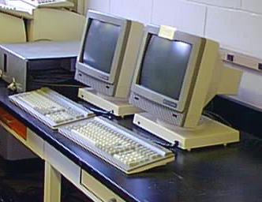
History Phase II: Hardware Cheap, Humans Expensive
Hardware: terminals
OS design goal: more efficient use of human resources
  Timesharing systems: each user can afford to own
  terminals to interact
  with machines

Slide 22
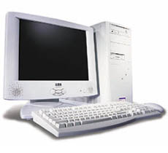
History Phase III: Hardware Very Cheap, Humans Very Expensive
Hardware: personal computers
OS design goal: allowing a user to perform many tasks at the same time
  Multitasking: the ability to run multiple programs on the same machine at the same time
  Multiprocessing: the ability
  to use multiple processors
  on the same machine

Slide 23
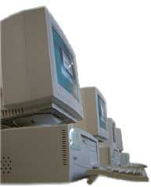
History Phase IV: Distributed Systems
Hardware: computers with networks
OS design goal: ease of resource sharing among machines

Slide 24
The Bottom Line
OS designs need to adapt to changing technology

